Slide 1
Interview Skills Workshop

Slide 2
Process
Submit Resume to Recruit A Duke
Hear back from the company
On-campus/phone interview
On-site interview
They’ll tell you when you can expect to hear back from them

Slide 3
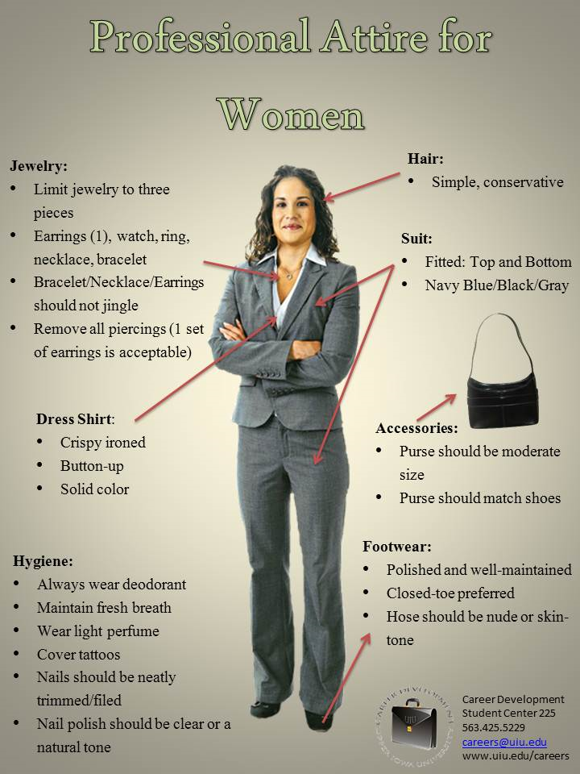
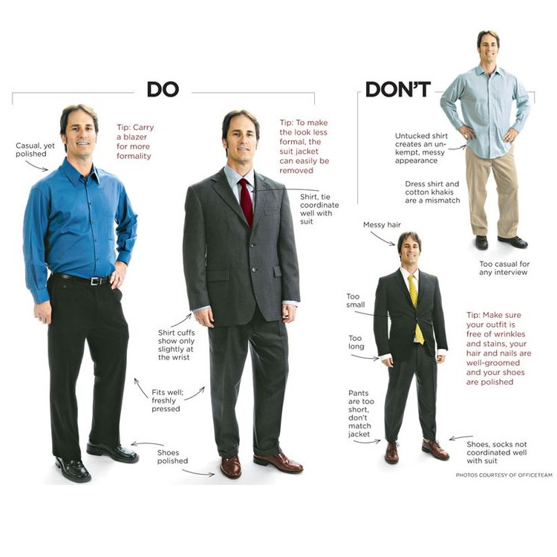
How to Dress
Impressions
Movement
Attitude
Grooming
Etiquette

Slide 4
Do’s and Don’ts
Conservative and professional
Solid dark colors
Offer a firm handshake
Make eye contact
Be yourself
SMILE
Wear untucked/wrinkled clothing
Falsify your resume
Make excuses
Fidget or slouch
Wear excessive jewelry/accessories
Wear clothes that are too tight

Slide 5
Behavioral Interview
Employers look at past behavior to help them predict future success in the position
If you don’t have relevant work experience, cite examples from campus organizations, group projects and other involvement.
“Tell me about a time when you…”
Recall situations that showed an action and be prepared to explain the details.
Actions should have a beginning, middle and end. Interviewers will want to learn about the outcome

Slide 6
STAR Methodology
Situation – Named Philanthropy Chair for an organization
Task – Raise money for a Children’s hospital
Action – Headed a committee to design, develop and implement a game show event to raise money.
Result – Raised X amount of dollars

Slide 7
Case Studies
Practice a case study before your interview
Take your time when initially reading the case
Make plenty of notes on the case
The interviewer is there to help you
Stand behind your decision – they just want a solid justification
There is no right answer!!!

Slide 8
After the Interview
Send a thank you email
Prepare for future interviews
Be patient

Slide 9
Networking
When at an event with new people, approach small groups (2–3 people), introduce yourself and join in the current conversation.
Remember names and repeat them in conversation. If you forget someone’s name, simply ask them to repeat it.
Handshakes: Always stand to shake someone’s hand, a firm confident handshake (known as the web-to-web) with the entire hand is best, always make eye contact when shaking hands.
At pre interview dinners hold your drink in the left hand to keep your right hand free and dry.
Asking questions is the best way to open lines of communication with someone new.
Your body language will set the tone: Give a strong handshake, Lean forward — Show interest, Smile — Pleasant facial expressions, Uncross your arms, Keep your head held high, Make eye contact.

Slide 10
Resources
Recruit A Duke
Interview Stream
JMU Career and Academic Planning
Company websites
Glassdoor

